Slide 1
K-Nearest Neighbors
Continuous variable prediction for image completion

Slide 2
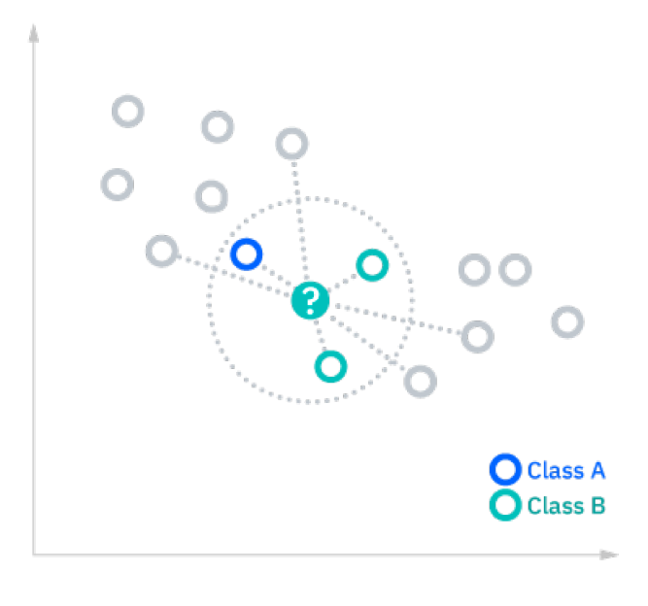
Understanding KNN
Algorithm evaluates neighbors of a given data point
Applied to estimates a continuous variable (regression) or to classify a data point as belonging to a some bucket (discrete classification).
K describes the number of neighbors considered
Nearest Neighbors are computed by distance from the considered element.
Distance can be computed via Euclidean distance, Manhattan distance, or other.
Image source: IBM

Slide 3
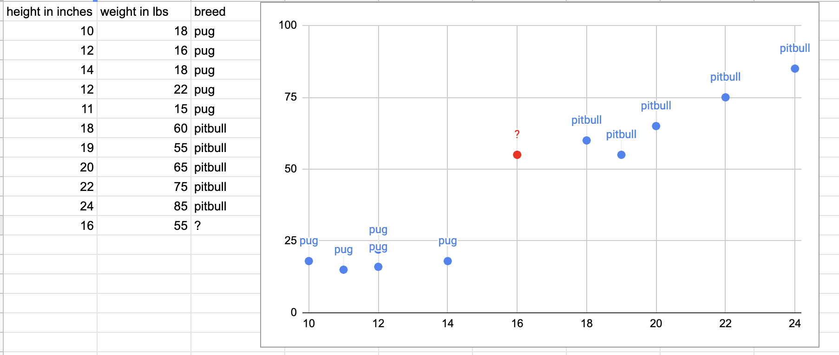
Visualizing KNN for discrete classification

Slide 4
Visualizing KNN for discrete classification
K = 4
Find 4 Nearest Neighbors
Nearest Neighbors vote: 3 pitbulls : 1 pug
Thus we classify as pitbull!

Slide 5
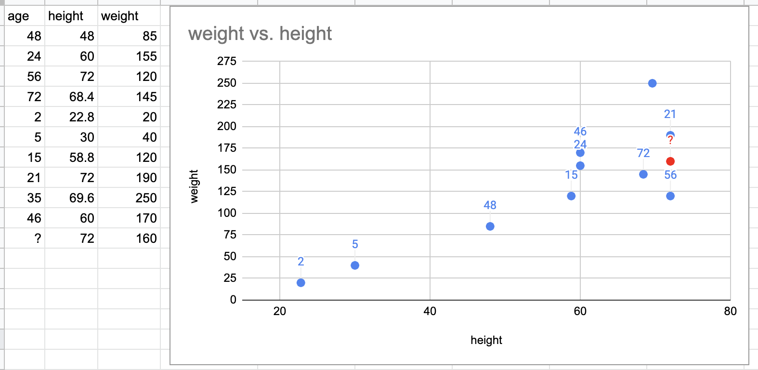
Visualizing KNN for regression (continuous variable)
Given a height and weight, could we predict an age?

Slide 6
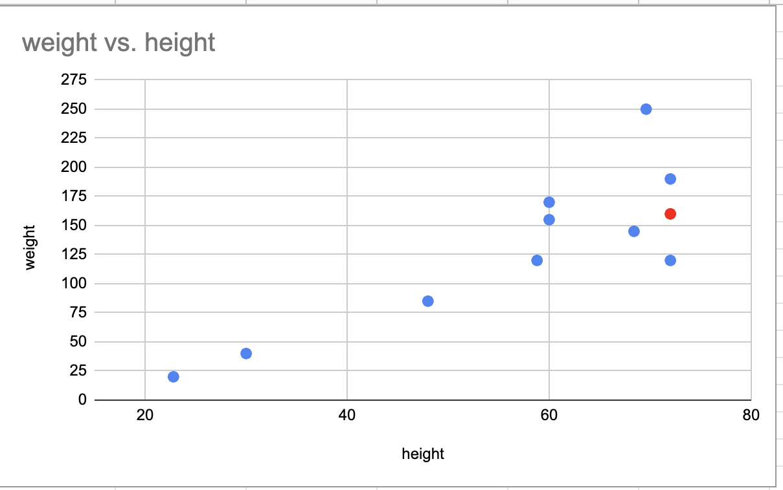
Visualizing KNN for continuous dependent variable prediction
K=3
We take some average of the ages of the neighbors
Median = 56, mean = 49.66

Slide 7
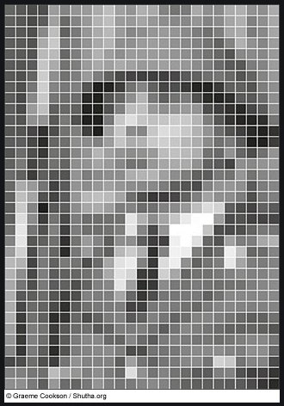
Visualizing our implementation
Let P be a black and white image
Consider P can be represented as a 2d array (matrix) of luminosity values:
P=[x][y]
x is the row
y is the column
Z_{xy} is the brightness of that pixel

Slide 8
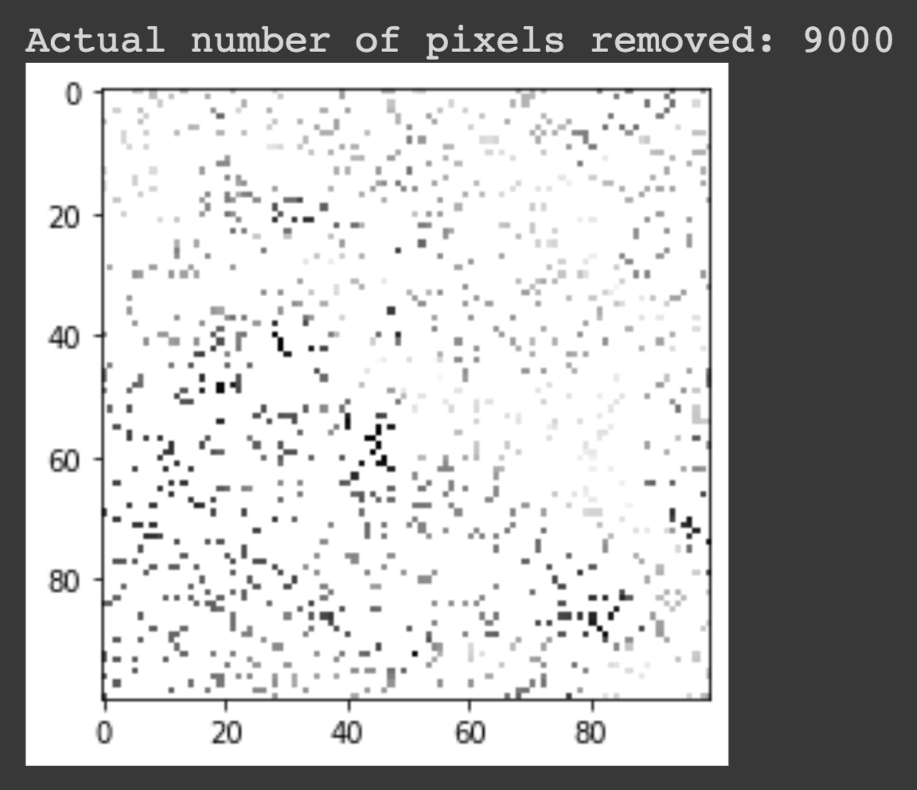
Can we guess the lumosity?
Given an image with 90% of the brightness values removed, can we guess the appropriate lumosity for the missing pixels?

Slide 9
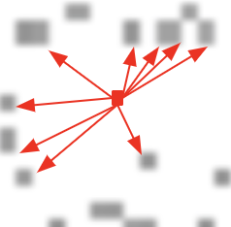
What are the Neighbors in this context?
A pixel with a missing luminosity still has known x-y coordinates, as an image implies a matrix that is complete in x and y dimensions
We thus check the Nearest Neighbors in x-y space.
Those that do have a lumosity are considered
The mean of the K-Nearest determines the luminosity of our target pixel

Slide 10
Demoing

Slide 11
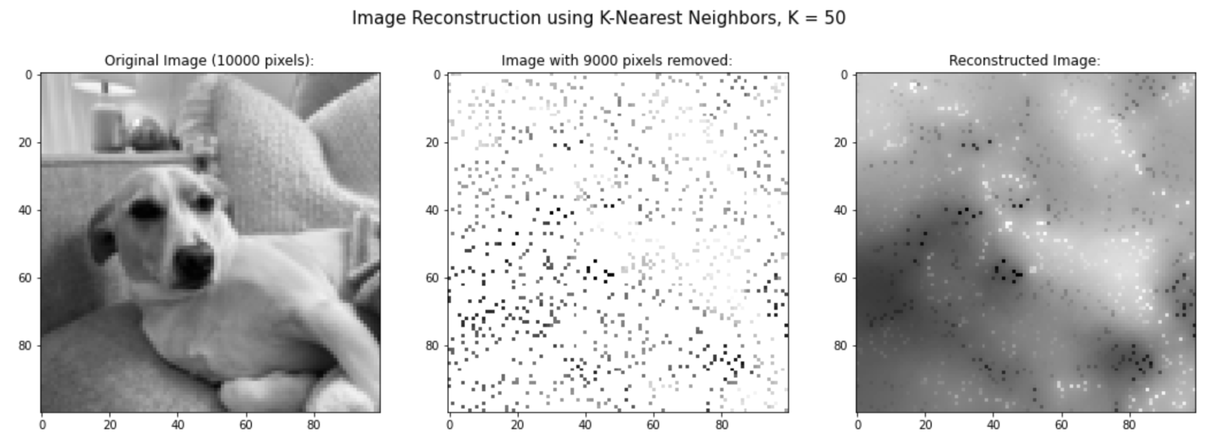
Results for 90% image deletion, K=50 (K too big)
(Some results to demonstrate tuning K)

Slide 12
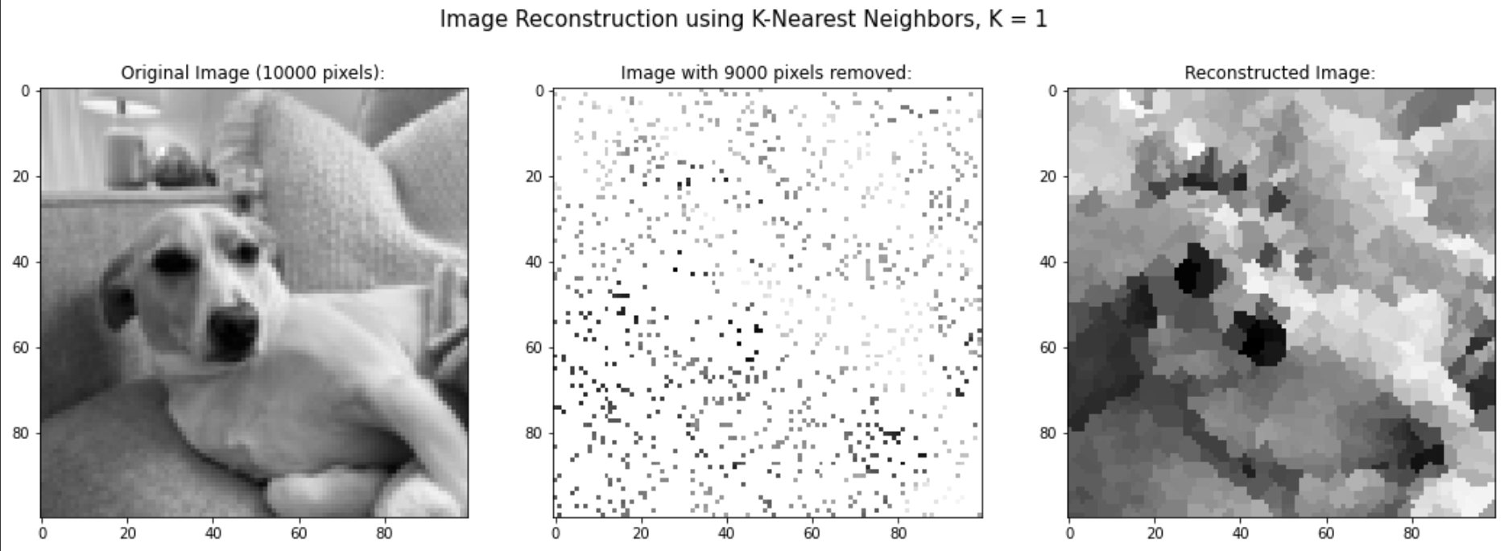
Results for 90% image deletion, K=1 (K too small)
(Some results to demonstrate tuning K)

Slide 13
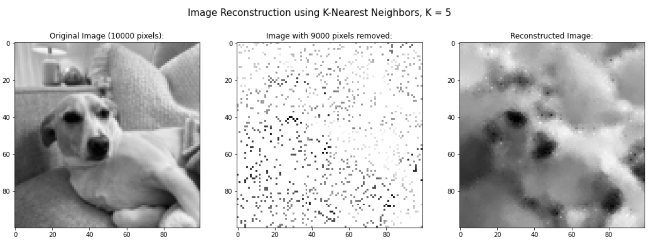
Results for 90% image deletion, K=5

Slide 14
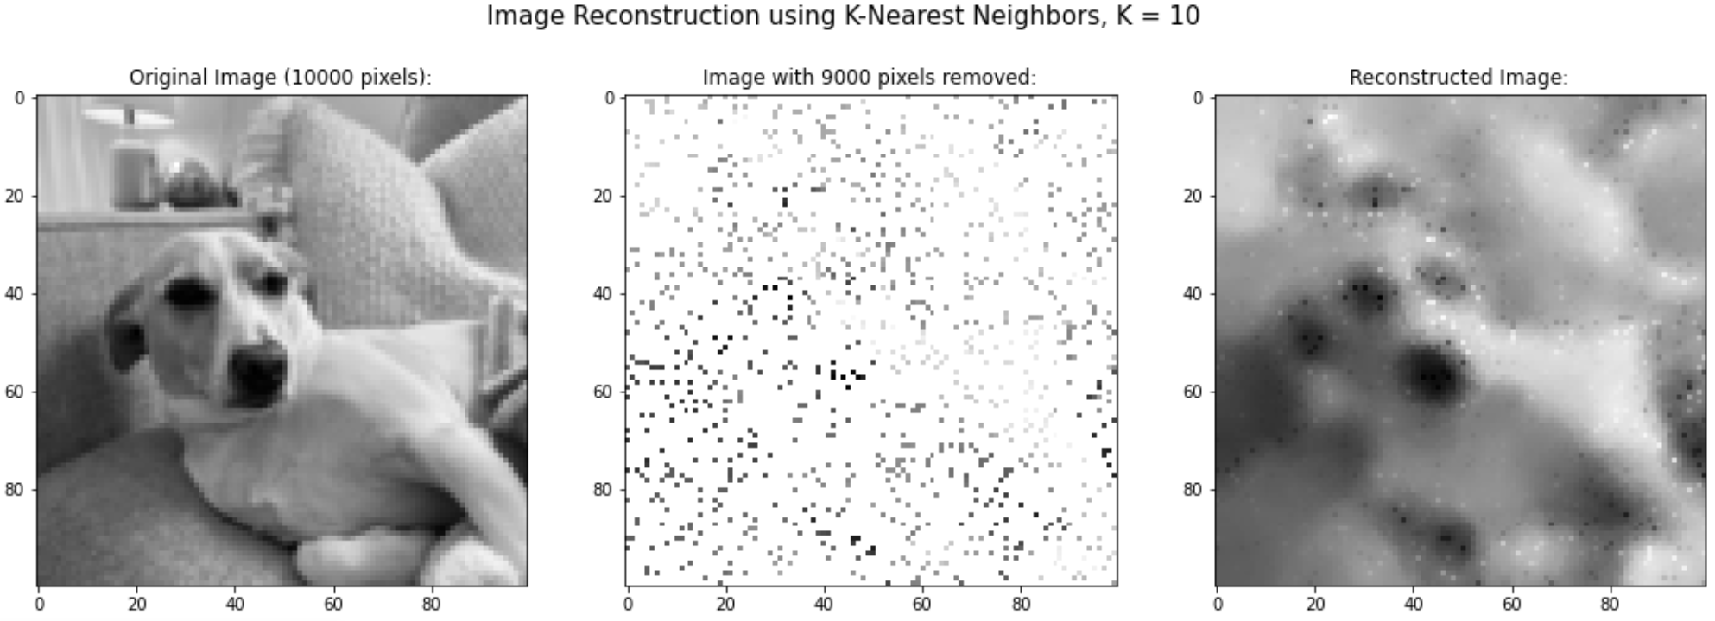
Results for 90% image deletion, K=10

Slide 15
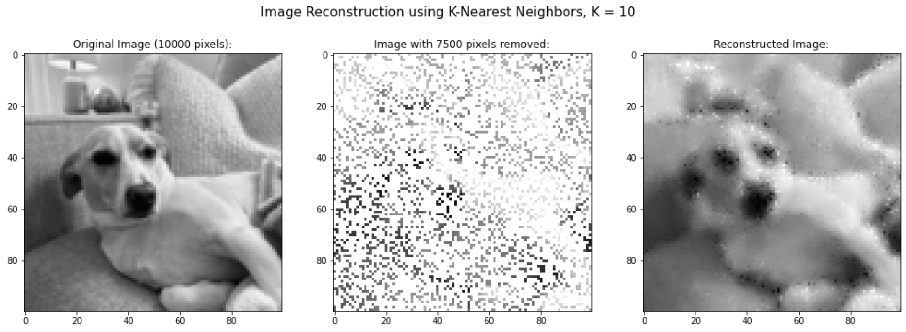
Results for 75% image deletion, K=10

Slide 16
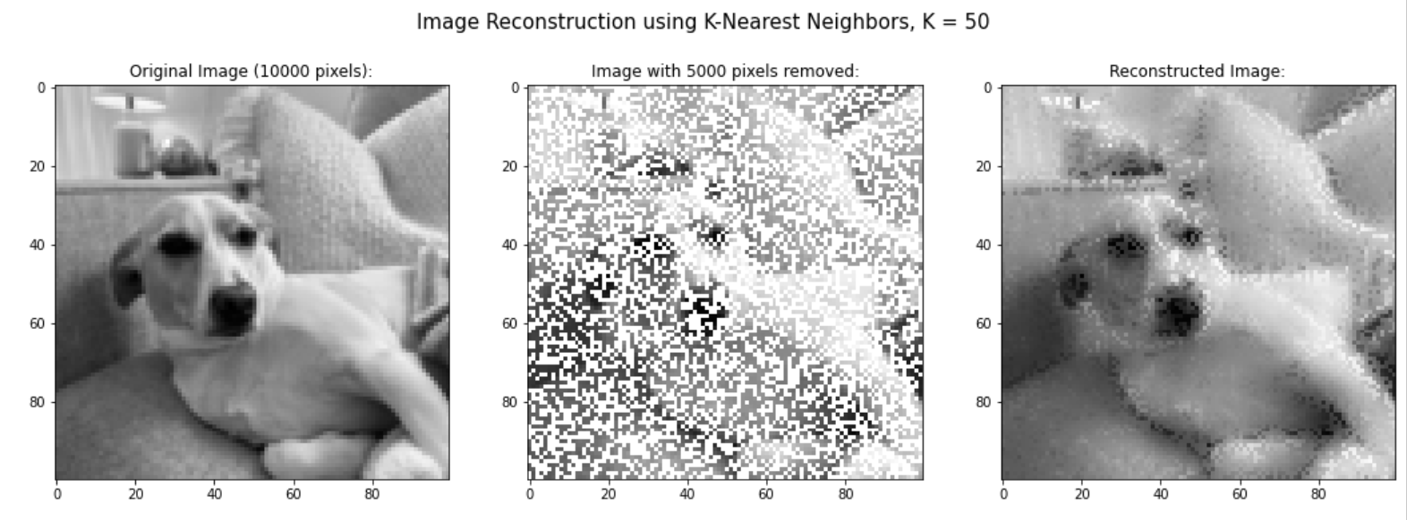
Results for 50% image deletion, K=50

Slide 17
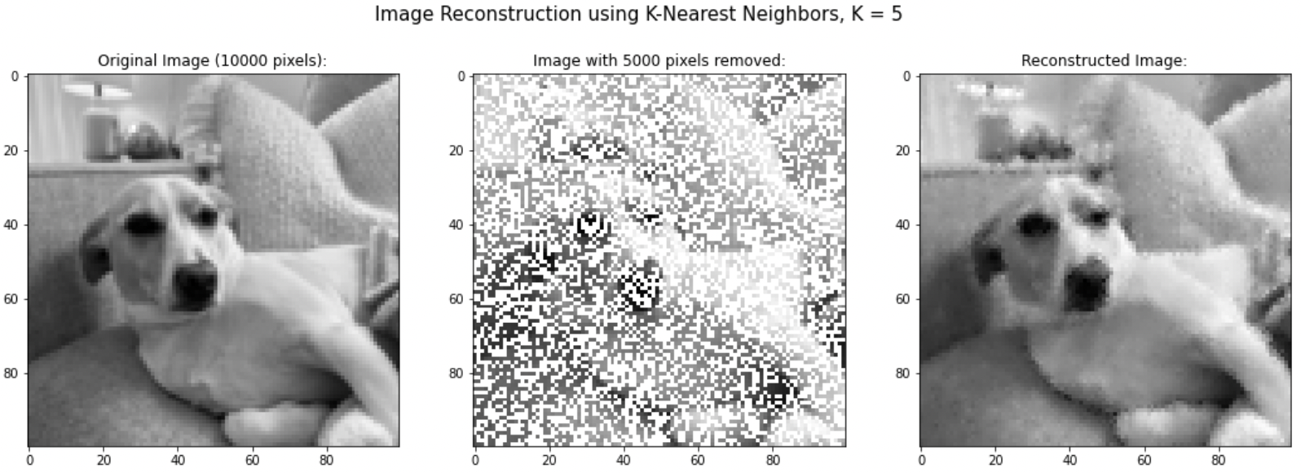
Results for 50% image deletion, K=5

Slide 18
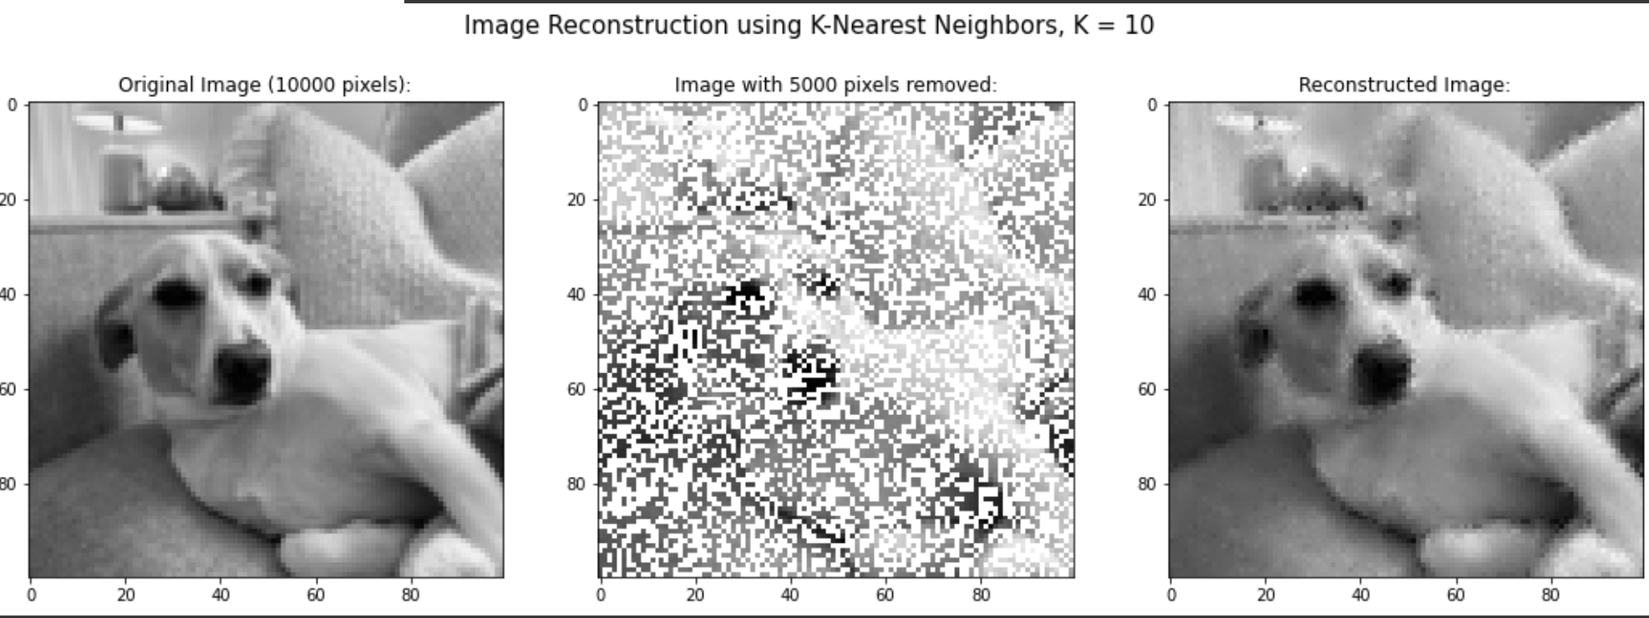
Results for 50% image deletion, K=10

